Slide 1
The School Enrollment System
Final Project: Enrollment System using Python and SQL
Hazel Anne Mozo

Slide 2
Scope
What is
What isn’t
A simple Enrollment System
A student can (1)create an account, (2)add and remove a course, (3)finalize their course list, and (4)get their timetable.
An admin can (1)add info to a students account, (2)generate a professors roster, and (3)generate reports.
An Enrollment System with password system.
A student can’t (1)search for specific courses, (2)the courses offered are not specific for their programs, and (3)they cannot immediately see their maximum allowed units and current total units.
The system does not retain info entered during trials

Slide 3
What are we discussing today?
Schema
Code Design
Demo
Analysis
ER Diagram with Crow’s foot notation
.ipynb file in Jupyter notebook
Explore the program
Take a look at the graphs

Slide 4
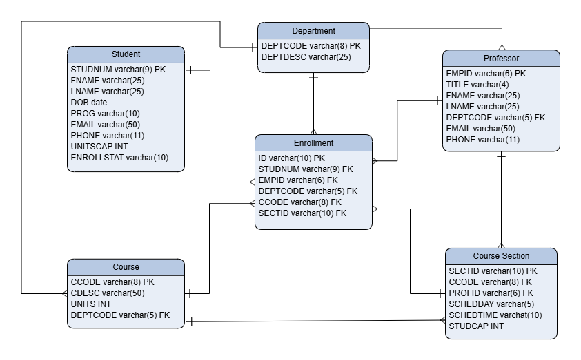
Schema
Required:
Student
Professor
Department
Course
Enrollment
Added:
Course Section

Slide 5
Code Design
To make sense of what I needed and what needed to be done, I looked into the data first. I created the schema and coded the table creation part of the Enrollment System.
Creating tables
I created the Student Menu to have a list of what I need to code. To make sure that the Menu options work, I also coded the Classes (Student and Enrollment System).
Student Menu Creation
Class Creation
It was towards the end that I realized that an Admin Menu was needed to assign max units and for the required reports.
Admin Menu Creation

